Slide 1

An analysis of marketing data
Protein works interview task
Adam Grove

Slide 2
Introduction
Overview: This presentation will show how I completed the data tasks, focusing on the specific tools and skills employed.
Audience: I've tailored this presentation to address the needs and interests of our data team members.
Focus: I'll discuss my methods, justify my tool choices, and recommendations for future projects.
Structure: The presentation will be divided into four main sections: data cleaning, insights drawn from a dashboard, univariate analysis then conclusions and recommendations.

Slide 3
Methodology
1
2
3
4
5
Data Exploration and Cleaning
A:R Efficiency
High Engagement Areas
Emerging Trends
Univariate Analysis
Python
Power BI
R

Slide 4
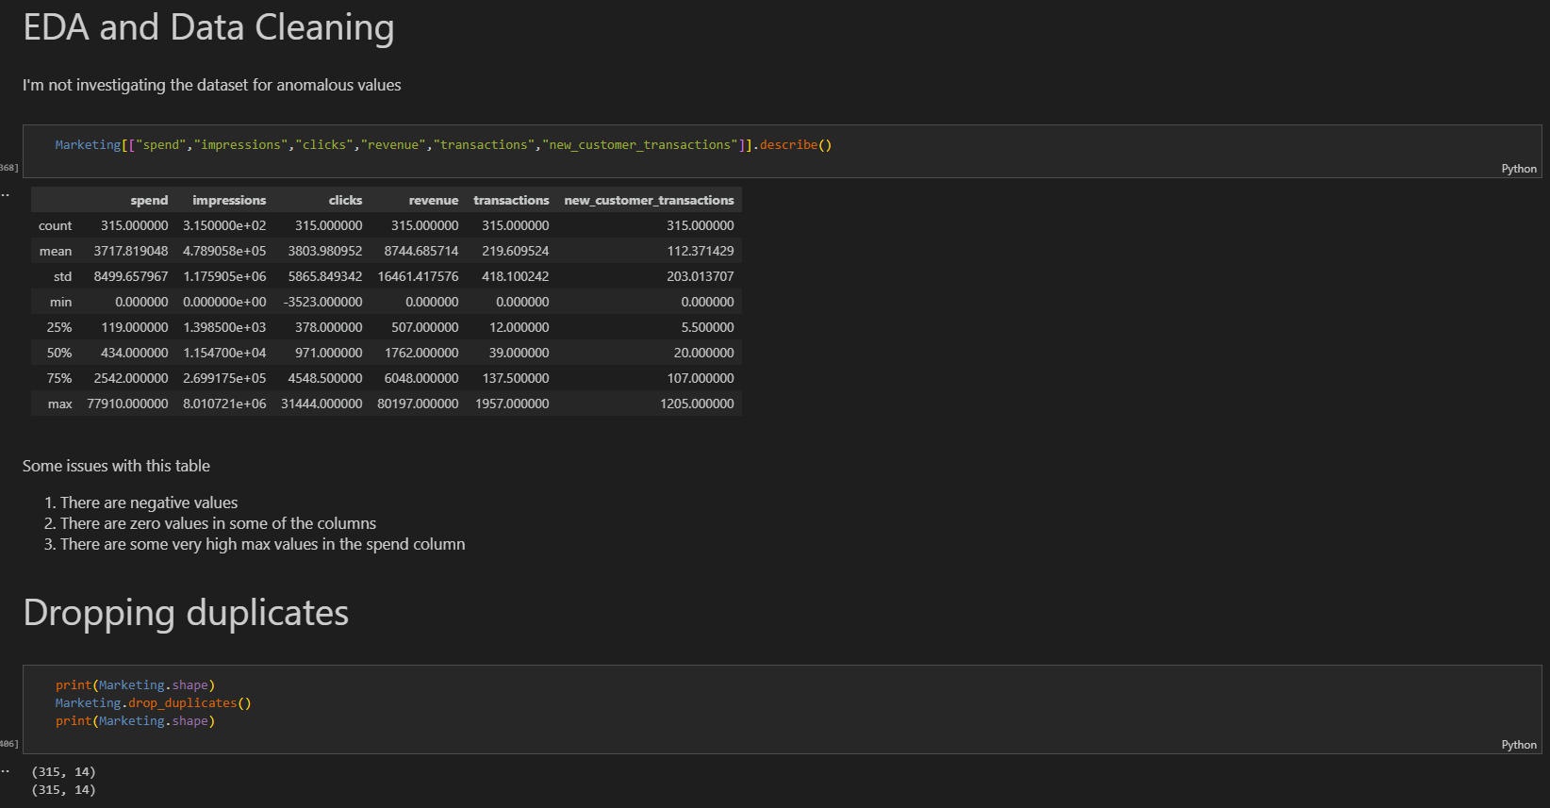
Data Exploration and Identification of Anomalous Results

Slide 5
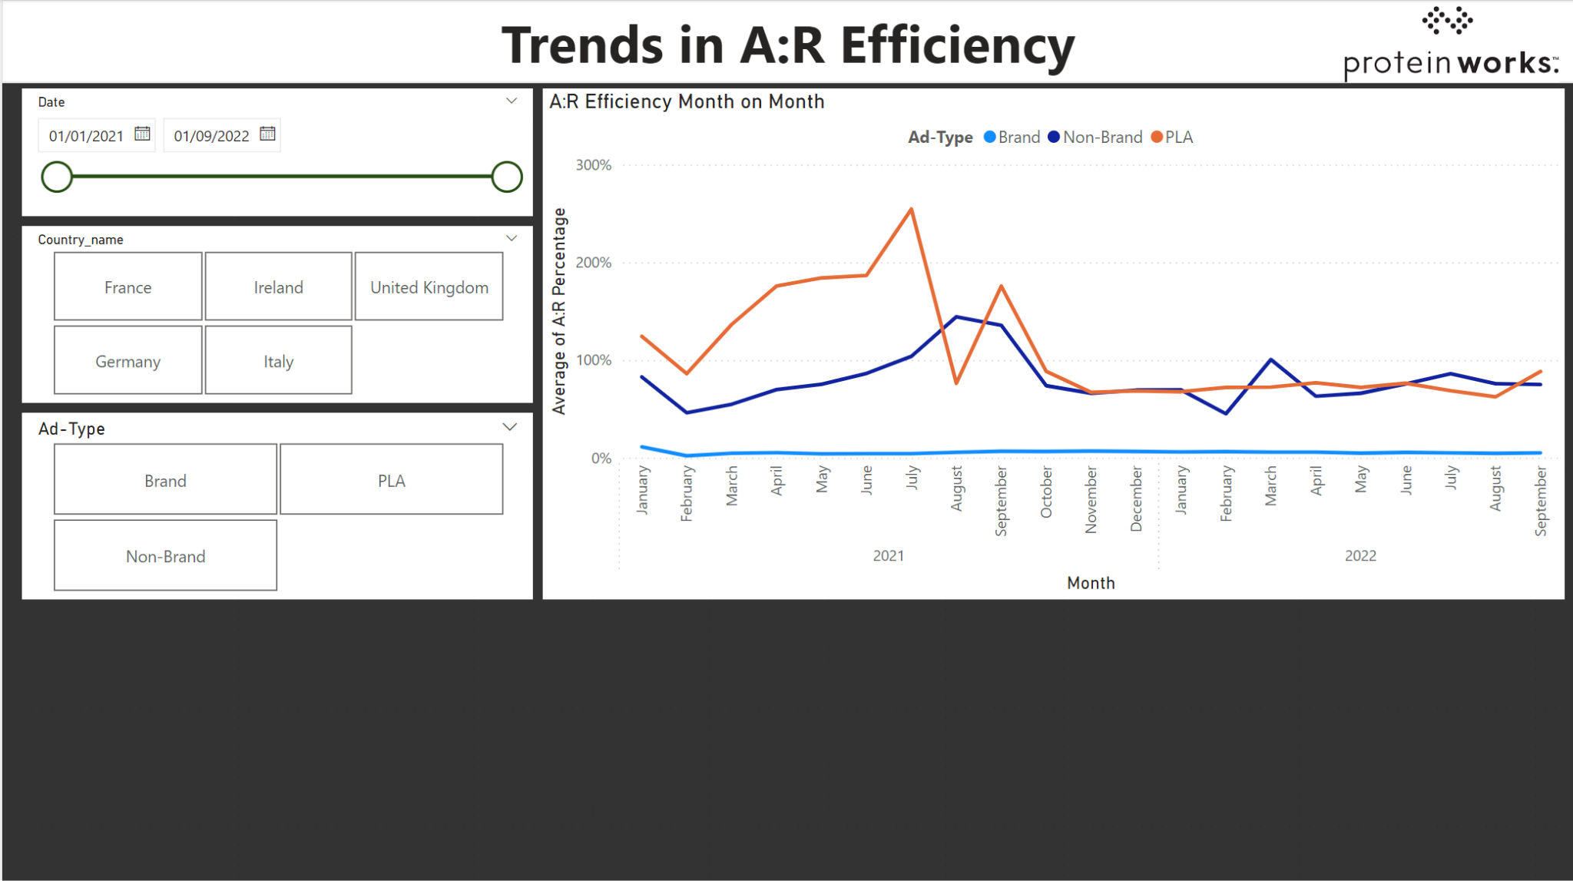
Investigating A:R Efficiency

Slide 6
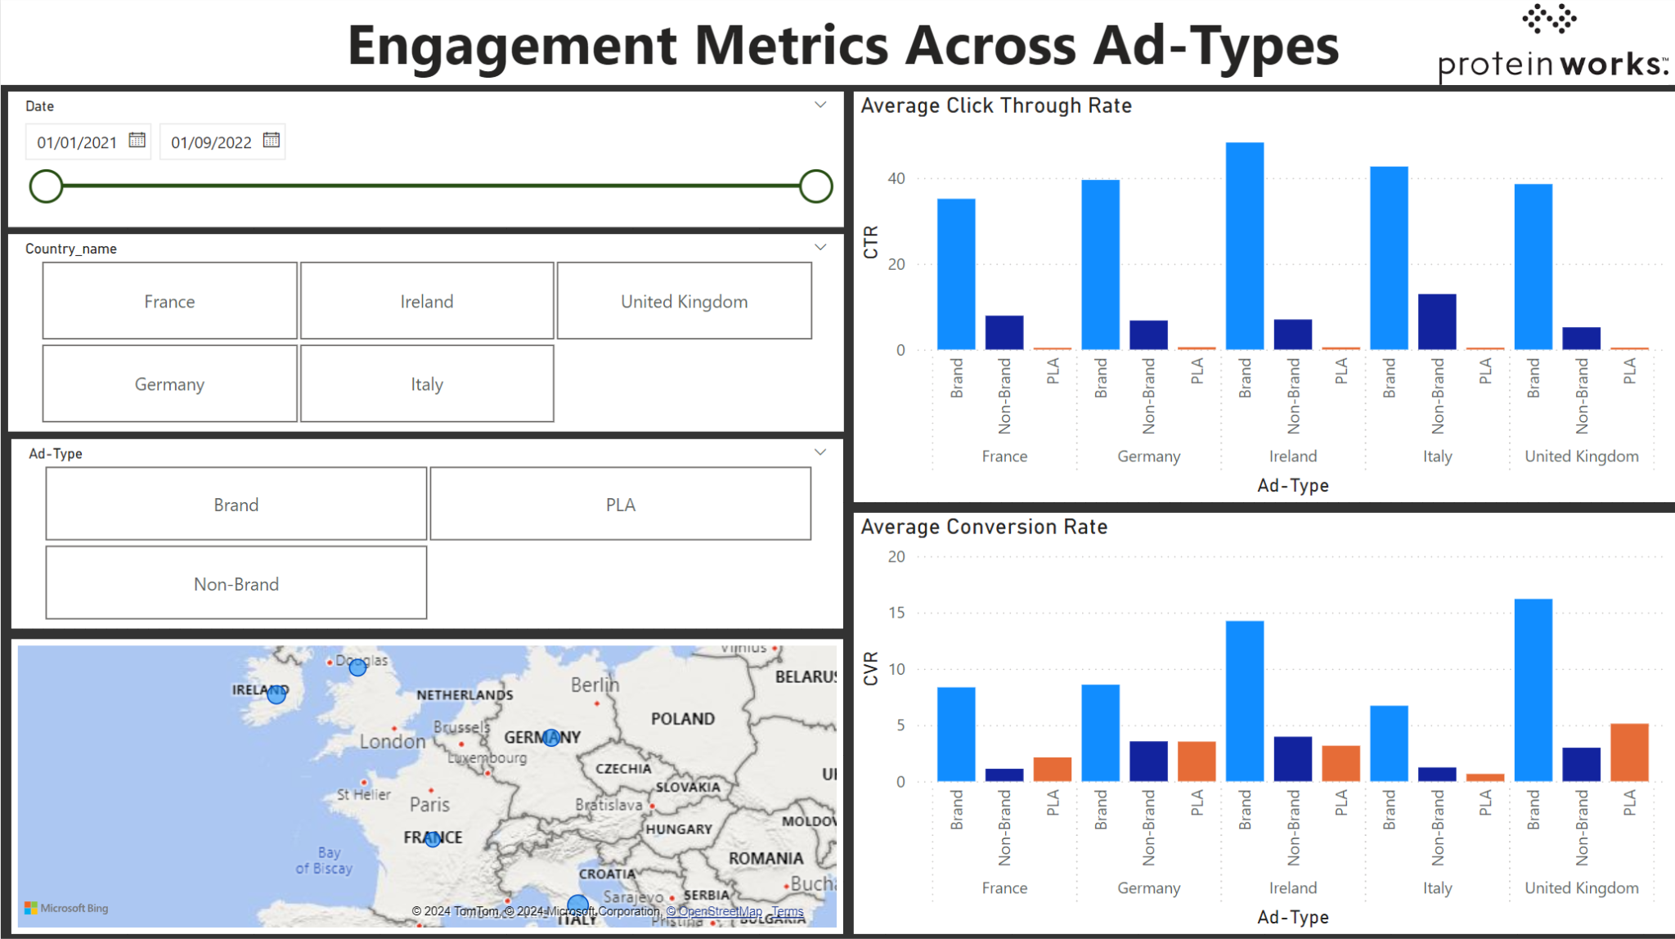
Highlighting high engagement areas

Slide 7
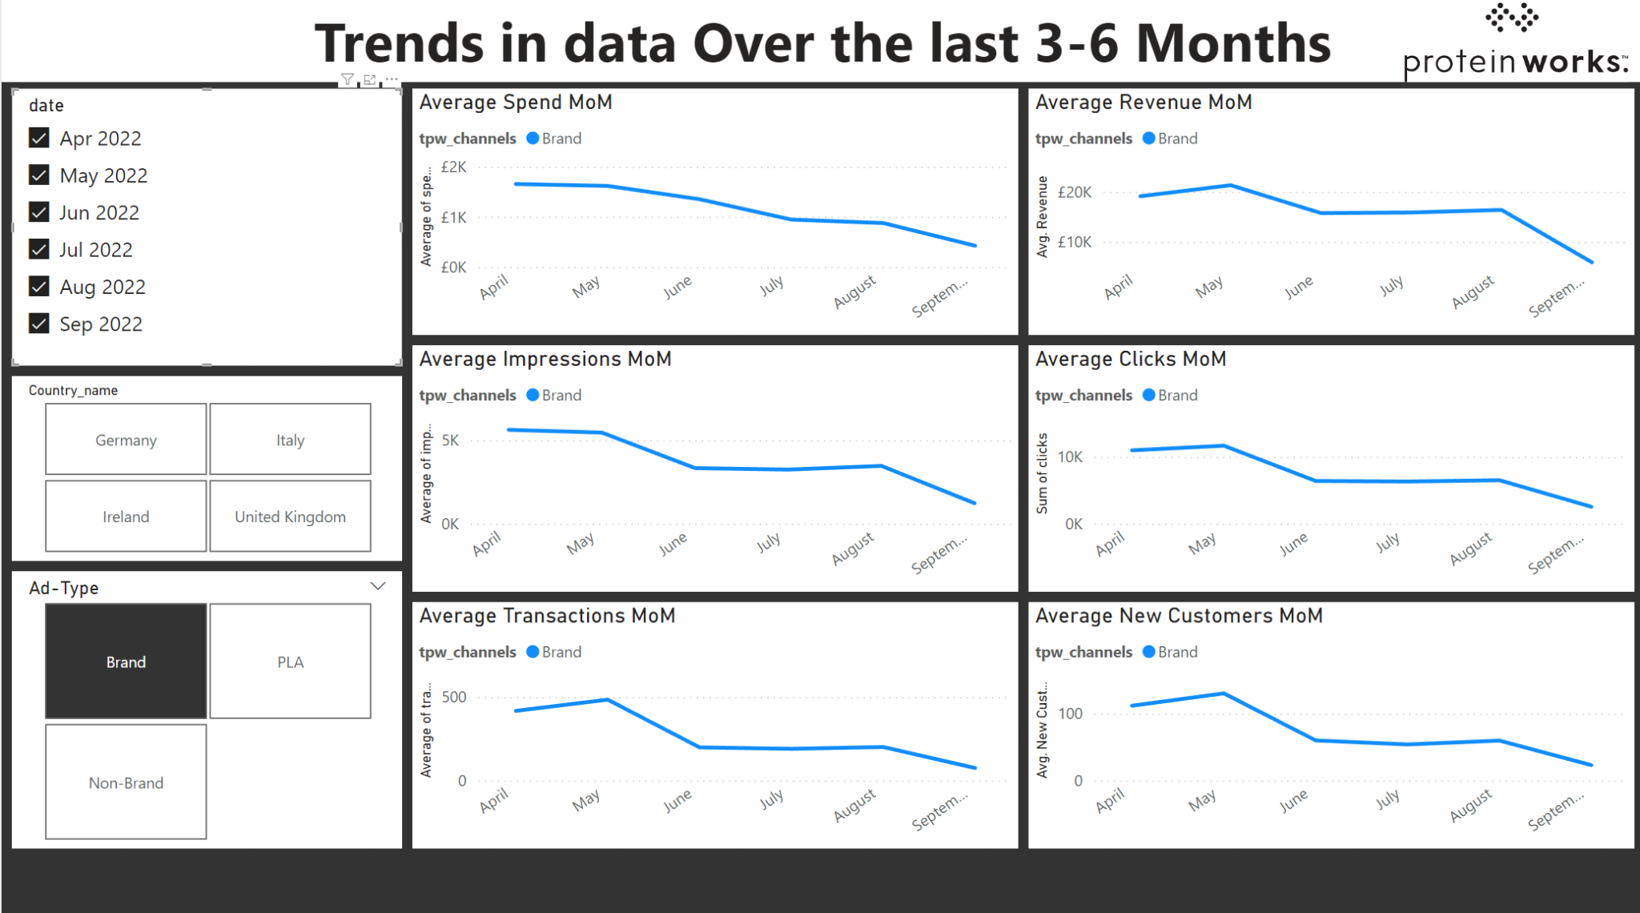
Identifying Emerging Trends

Slide 8
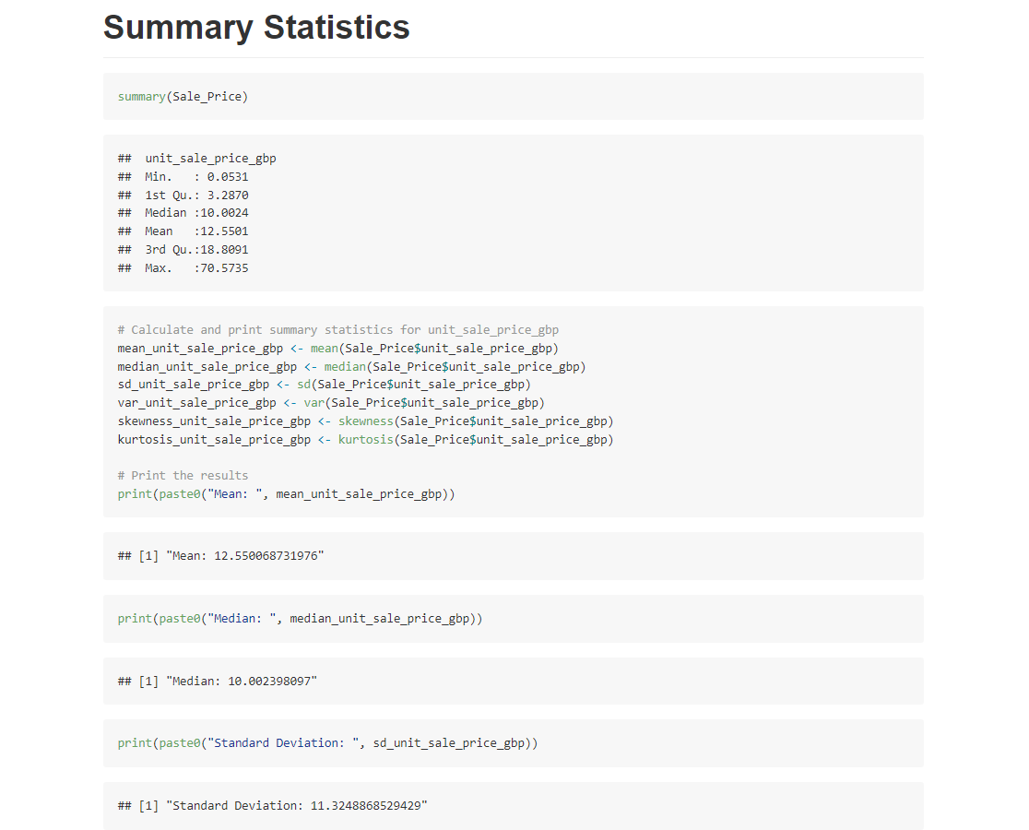
Univariate analysis of Sales Data

Slide 9
Conclusions and recommendations
Conclusions
There were many records that could be classified as anomalous, the majority coming from Italy. Most anomalies were recorded from Non-Branded and PLA ads
Each country saw spikes in A:R efficiency, these are periods where ads are less efficient at generating revenue
Italy had the highest overall engagement, Ireland for Branded Ads, Italy for Non-Branded and Germany for PLA ads
There has been a decrease in all measures for Branded and Non-Branded ads across europe
Unit Sales Price data is right skewed and is not normally distributed

Slide 10
Conclusions and recommendations
Recommendations
Investigate data entry strategies, especially those in italy and those from Non-Branded and PLA ads
Capitalise on time periods throughout the year with low A:R ratio
Focus Ads in Italy as this region has the highest engagement. For each ad type there could be targeted strategies for the regions with the highest engagement
Adjust targeting strategies for Non-Branded and Branded ads as there has been a recent decrease in a performance measures
For further analysis of the unit sales data, using the median would be more appropriate

Slide 11

Thank you !
Adam Grove
Junior Data Analyst Interview - Protein Works
Link to GitHub Repository

